Slide 1



BUSINESS DATA MANAGEMENT
CAPSTONE PROJECT
DATA-DRIVEN STRATEGIES FOR SALES IMPROVEMENT AND RETAIL EXPANSION
NAME : ABHAY MAURYA
Roll No : 22F3001075

Slide 2

CONTENT
01
INTRODUCTION
02
CHALLENGES
03
DATA COLLECTION
04
DATA ANALYSIS
05
FINDINGS
06
RECOMMENDATION

Slide 3

INTRODUCTION
The project deals with Panchsheel Enterprises a micro-manufacturing unit based in Rudrapur, Uttarakhand.
It is the B2B segment in the production of plastic articles.
Panchsheel Enterprises promoters are Arun Maurya and Vikas Maurya.
It manufactures plastic articles of different sizes and shapes.

Slide 4
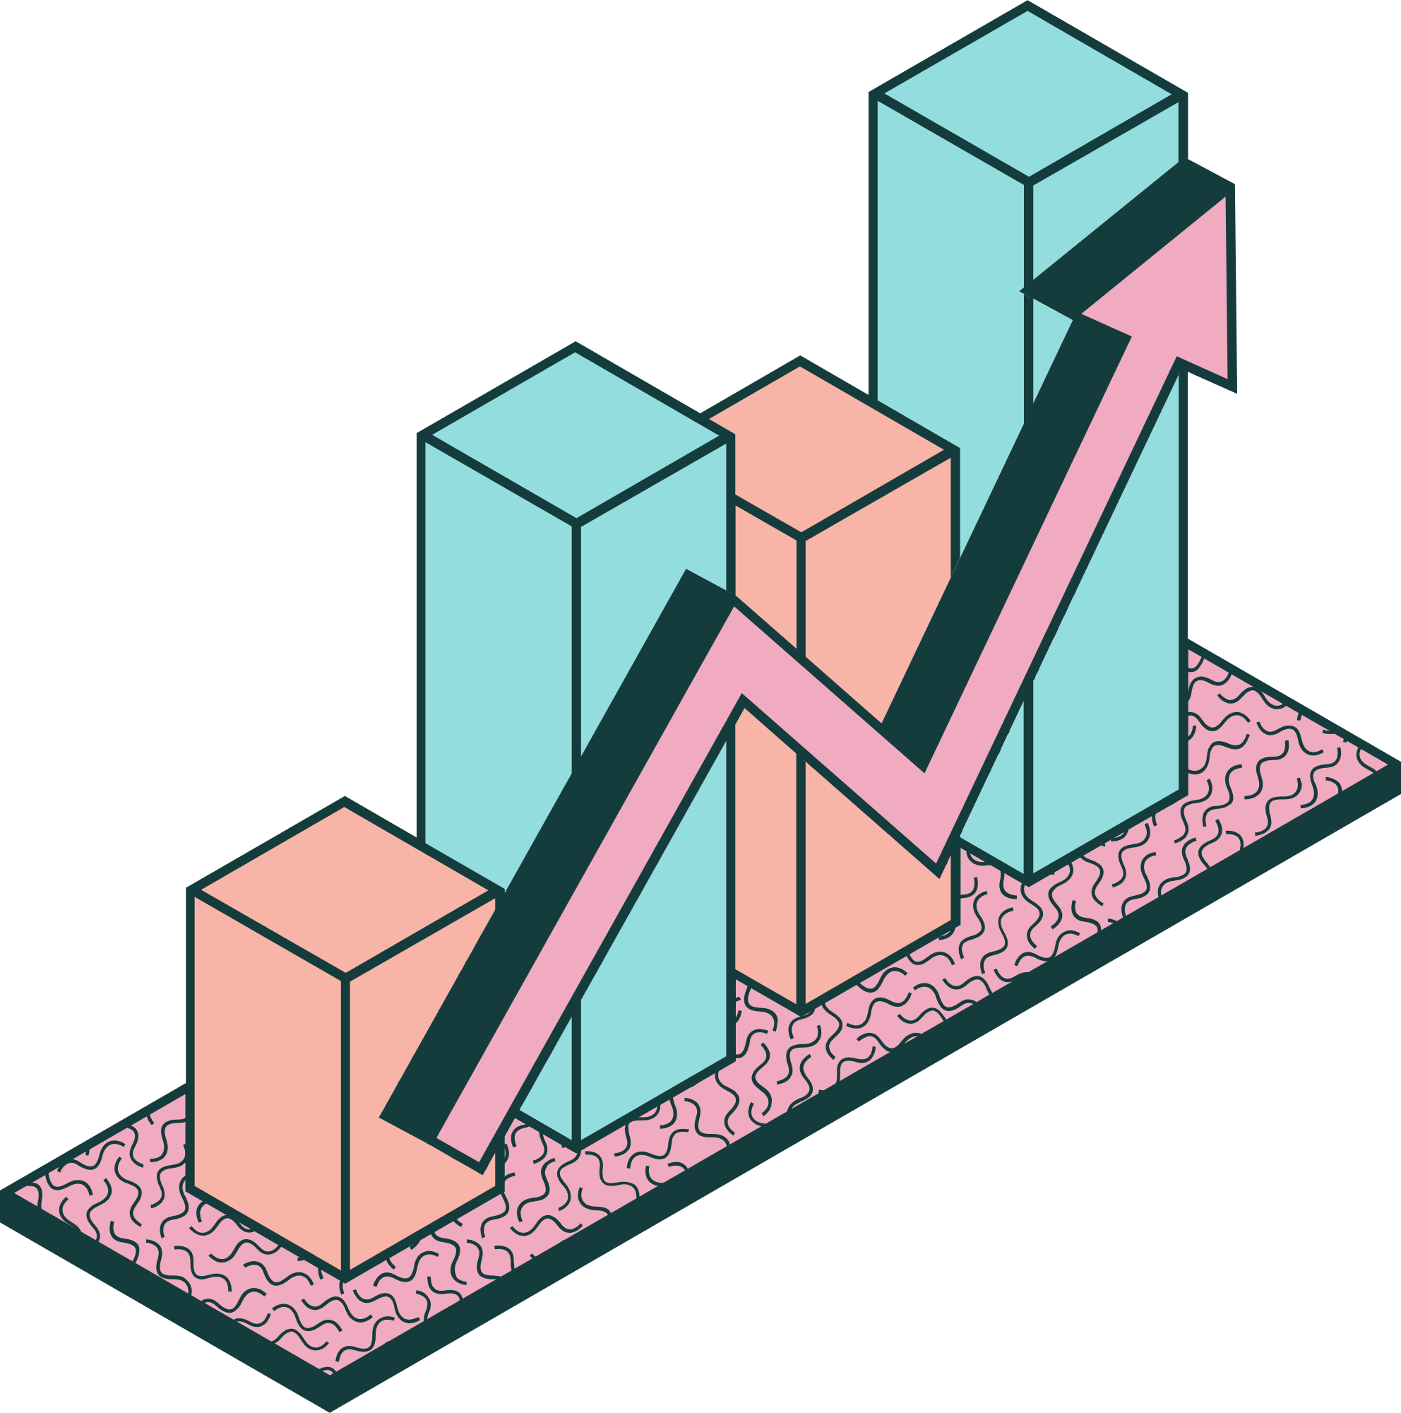



CHALLENGES
Sales Challenge
The business is struggling with a low frequency of orders and small order sizes, which significantly limits its growth potential
Need for Expansion Funds
The company requires additional capital to finance the further expansion into the retail markets.

Slide 5


DATA COLLECTION
The dataset was for the months of January to August 2024 and covered three SKUs: Handle, Colored Cap and Digital Meter Box.
All the data was unstructured and taken on paper-based forms in reporting sales, revenue, profit and costs.
For the second challenge, there was no formal data available, only discussions with retail shopkeepers were shared.
SALES
PRICE
COST
REVENUE

Slide 6
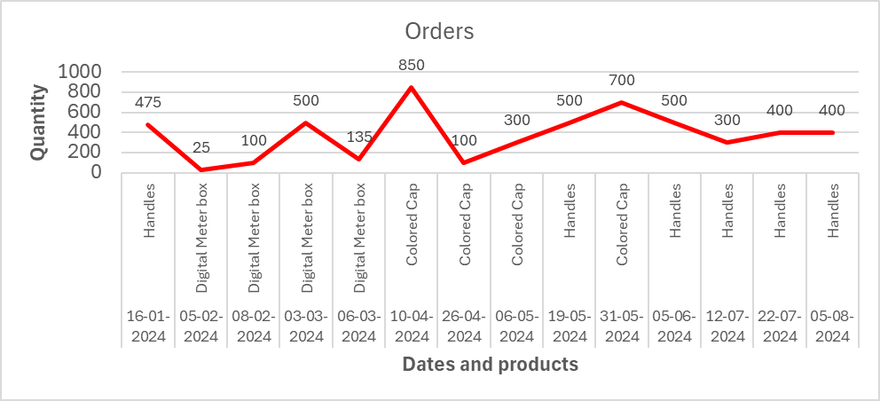
DATA ANALYSIS
SALES
Sales lack consistency over time.
Order sizes are typically very small.
Client orders are irregular and unpredictable.

Slide 7

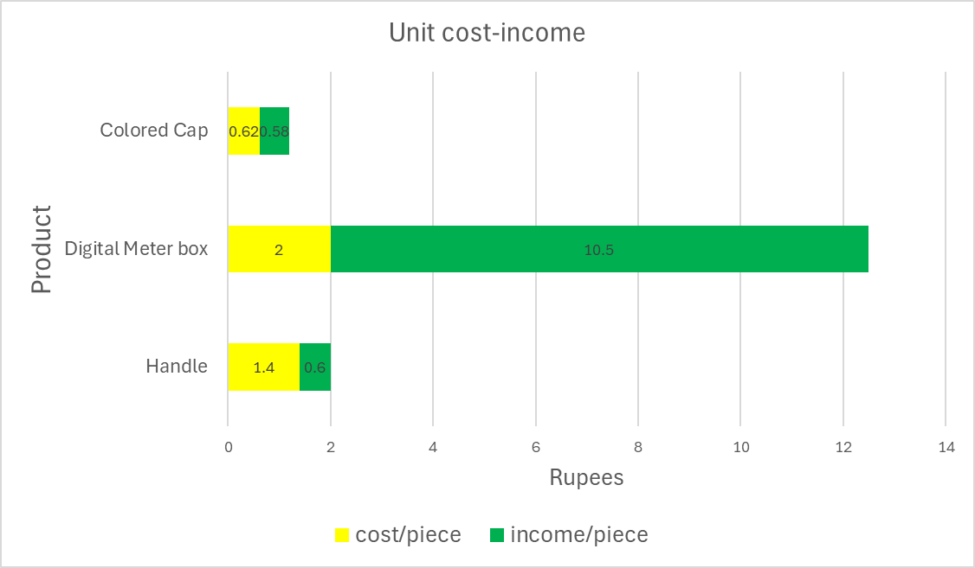
PROFIT
The Digital Meter Box has the highest income at ₹10.5 per unit, significantly higher than the other products.
The Colored Cap has the lowest cost per unit at ₹0.62, followed by the Handle at ₹1.4

Slide 8
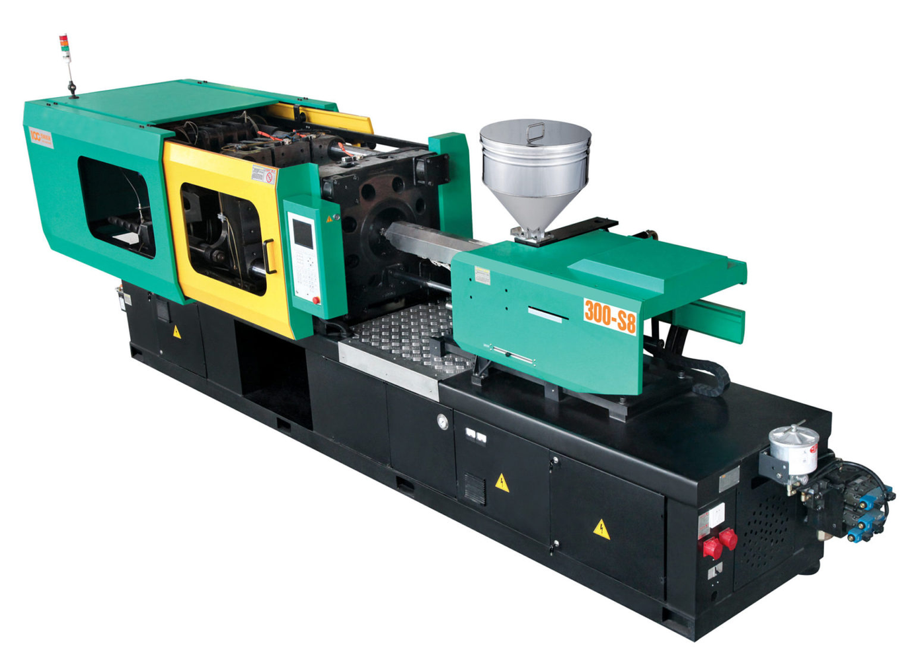

EXPANSION FUNDS
Low sales make it challenging to secure investment funds.
Significant capital is required for machinery, raw materials, labor and marketing.
The market for the product is highly competitive and saturated.

Slide 9


FINDINGS
Handles dominate sales in quantity due to frequent orders.
Digital Meter Box, while less frequently ordered, offers the highest profit margin.
Irregular orders and weak marketing disrupt sales consistency.
An optimal strategy is required for efficient retail expansion and utilization of funds.

Slide 10
RECOMMENDATION
Prioritizing client retention for frequent and high-value orders like Handles.
Focusing on high-margin products like the Digital Meter Box.
Strengthening marketing and industry connections for steady orders.
Strengthen B2B sales to secure stable revenue for funding.
Conduct in-depth market research to identify retail opportunities.
Seek external funding through investors or banks if necessary.

